Slide 1
PENSION MANAGEMENT
SYSTEM

Slide 2
TEAM MEMBERS
EMPLOYEE ID | NAME | RESPONSIBLITIES
911313 | Vijayalakshmi P | Authorization Microservice Web portal MVC
911259 | Bhuvaneshwaran K | Pension Process Microservice
911237 | Srikanth Mallipeddi | Pension Disbursement Microservice
911345 | Nishtha Sharma | Pension Details Microservice
Guided By:- Ramanuj Das
Mentored By:- Susha Raghunath

Slide 3
PROJECT OVERVIEW
The aims of this application is to automate a portion of the Pension detail provisioning.
This project covers pensioner detail provision, calculate provision, initiate pension disbursement.
The application has four microservices which is Authorization, Details ,Disbursement and Process pension.

Slide 4
PROJECT OVERVIEW
Process Pension Service
Pensioner Detail Service
Pension Disbursement Service
Pension Management Service
Client
API Gate-way
Authorization Service

Slide 5
PENSION MANAGEMENT SYSTEM-PROTOTYPE

Slide 6
WORKFLOW

Slide 7
AUTHORIZATION SERVICE
It has two mapping , one for authentication and another is for validation.
The details of the user is passed to the authentication manager
The user details service will load the data from the database.
The JWT will next generate the token and then return it.

Slide 8
JWT WORKFLOW

Slide 9
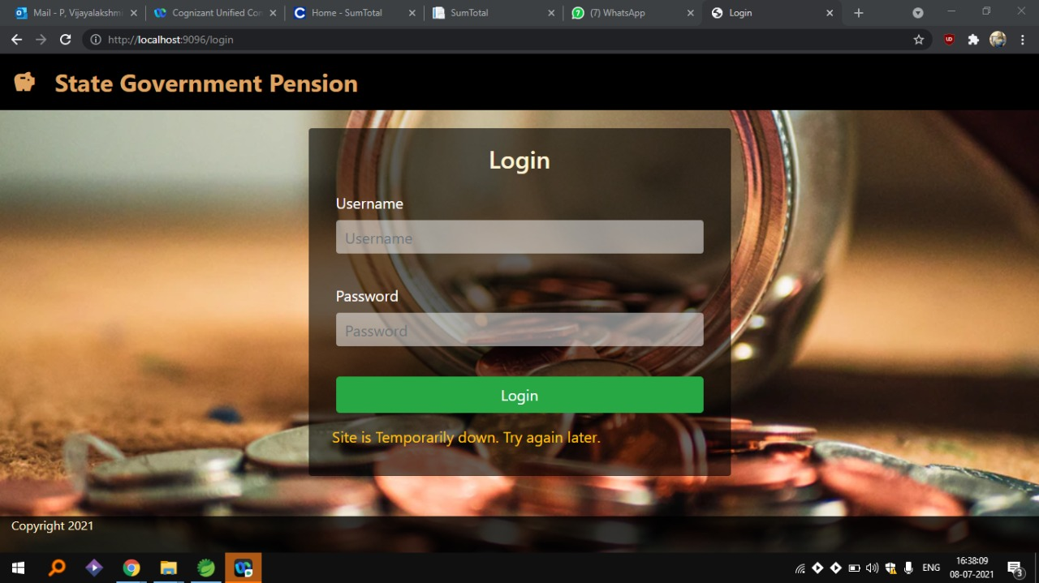
AUTHORIZATION SERVICE

Slide 10
PENSION DETAIL SERVICE
When the rest end point of this MS is hit, the controller class accepts the requests & calls the methods in the service layer for further process.
The class annotated with @Service is responsible for business logic, the methods in this layer performs some tasks & sends the response back to the controller.
The method in the service layer takes the Aadhaar number as a parameter & reads the pensioner details from the CSV file & returns back the result in form of list.
The method then checks for the Aadhar number in the list of Pensioner data, if the correct Aadhar number is found in hashMap then the method returns back the Pensioner details to the client or to any other microservices which sends the request.

Slide 11
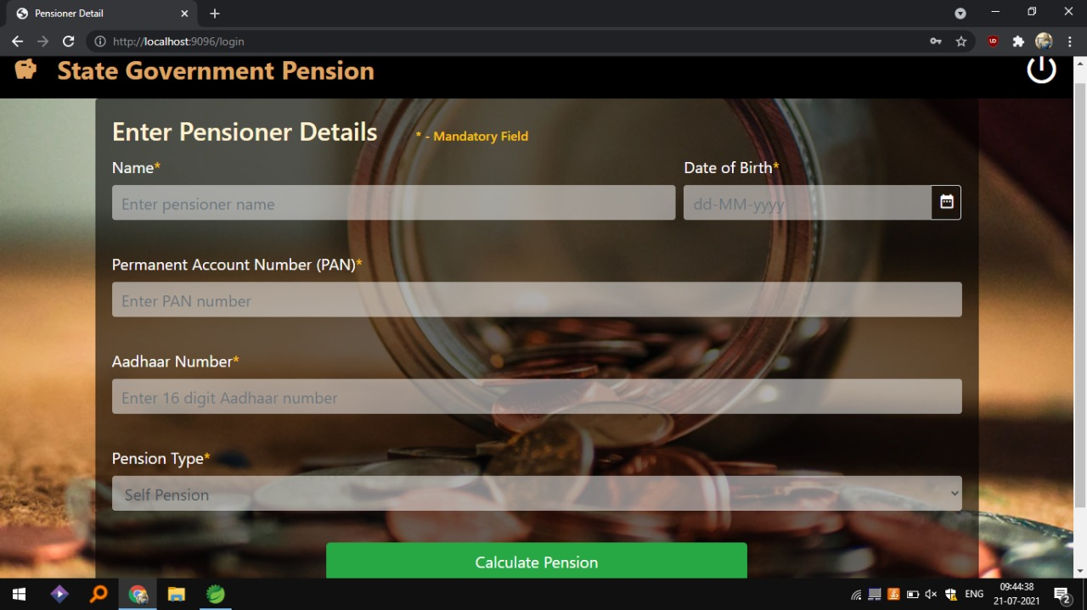
PENSION DETAIL SERVICE

Slide 12
PENSION PROCESS SERVICE
It is autowired to pension detail microservice and pension disbursement microservice.
It sends the aadhar number to pension detail microservice to get the pensioner details
It validates the pensioner details in the service layer of pension process microservice
After getting the type of pensioner as family or self it performs the required calculation in the service layer
The calculated pension amount is negotiated for service charge and the result is returned to the pension disbursement

Slide 13
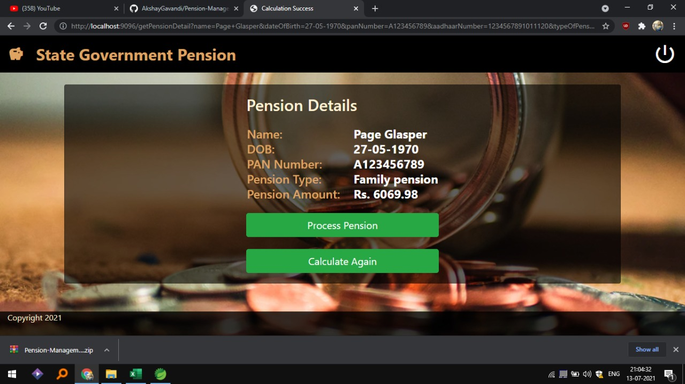
PENSION PROCESS SERVICE

Slide 14
PENSION DISBURSEMENT SERVICE
This pension disbursement microservice mainly calculates the service charge depending upon the bank type
The service class is responsible for calculating the service charge of 500 or 550 depending on the bank type of pensioner
The calculated service charge is then returned to the controller class for further process.
The controller class is autowired with the pension disbursement service layer and pension detail client .
The controller class requests the bank type of respective aadhaar number from pension detail client and returns the service charge.

Slide 15
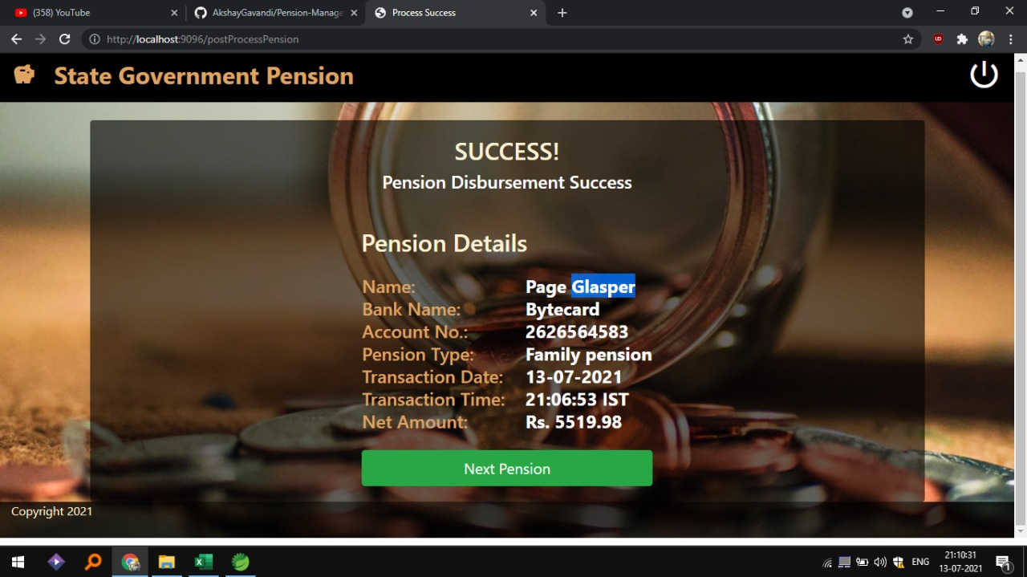
PENSION DISBURSEMENT SERVICE

Slide 16
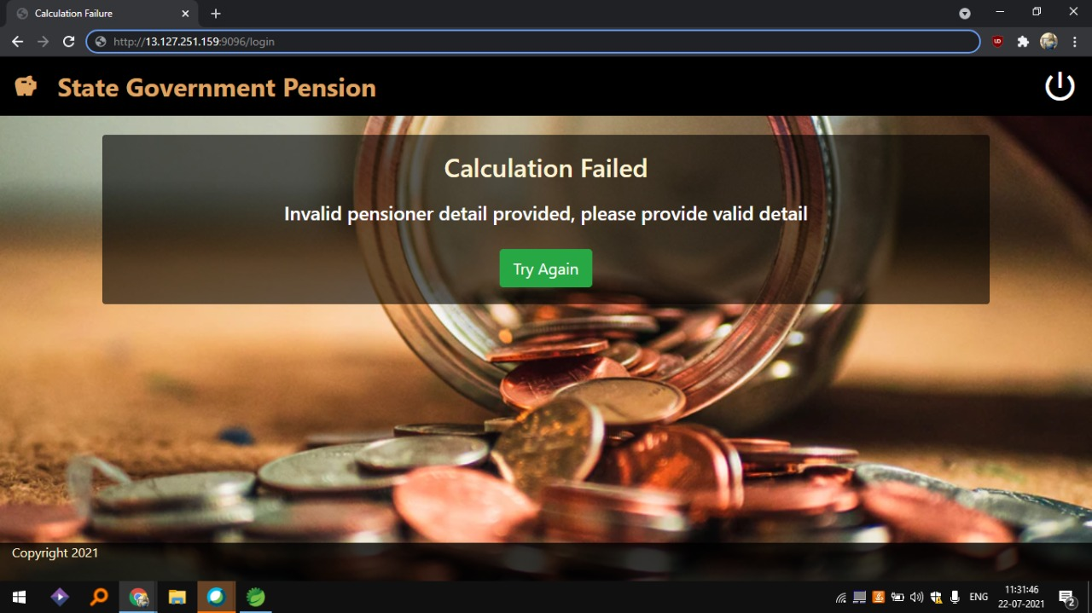

Slide 17
PENSION MANAGEMENT SERVICE
This is the client MVC application which allows members to login.
On successful login it asks for pension details.
Invokes the process pension microservice to get the details.
Validates the data .
Displays the processed pension details.
Saves the pension details in the database.

Slide 18
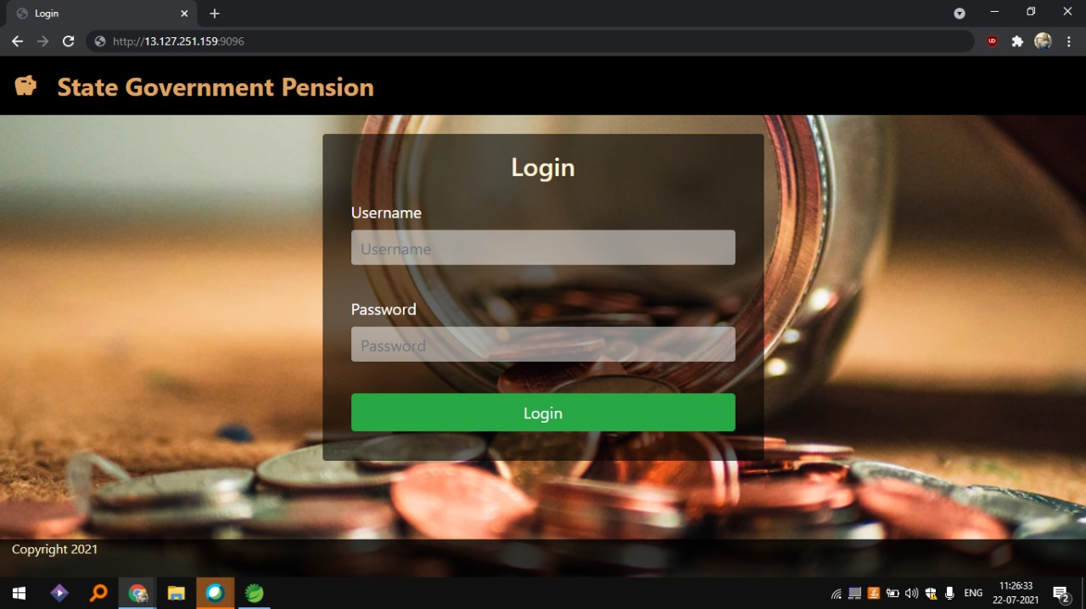
CLOUD DEPLOYMENT IN LOCALHOST

Slide 19
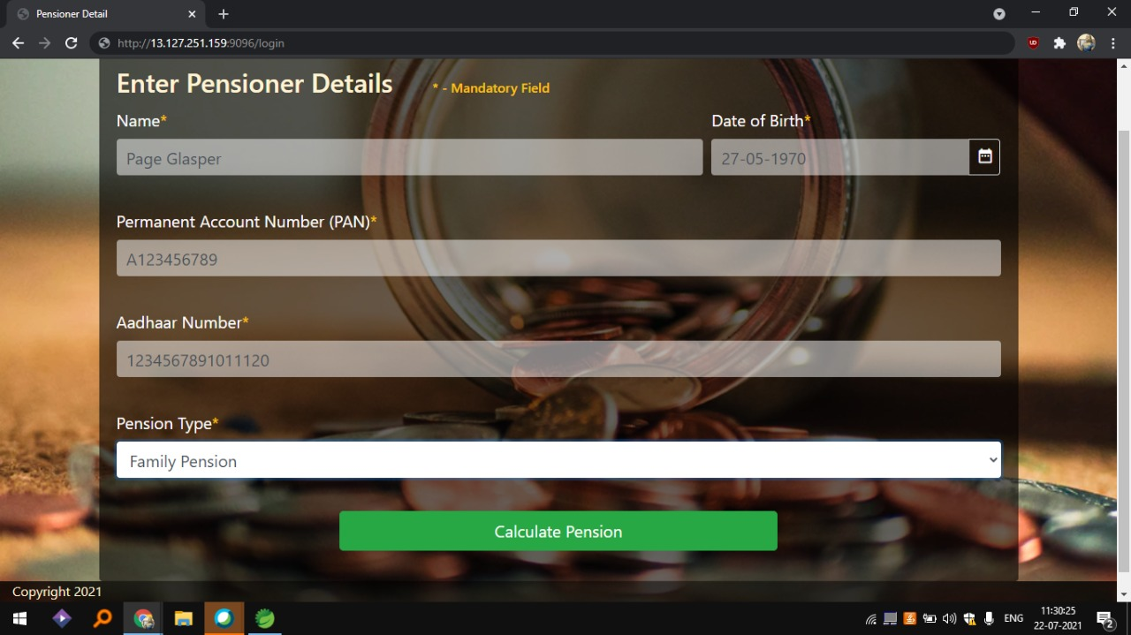

Slide 20
AWS DEPLOYMENT

Slide 21
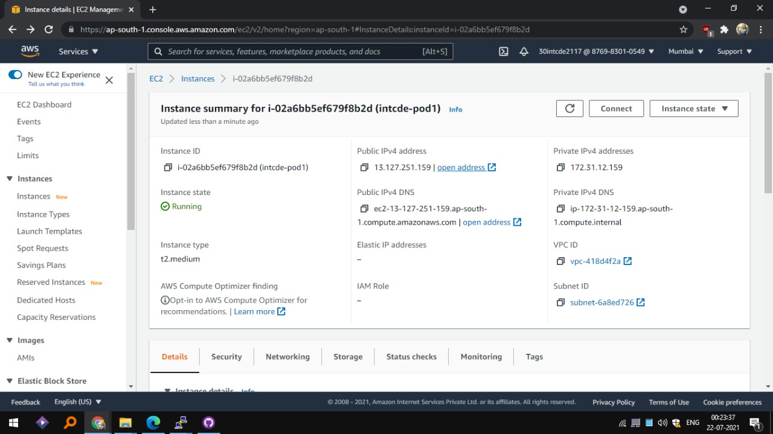
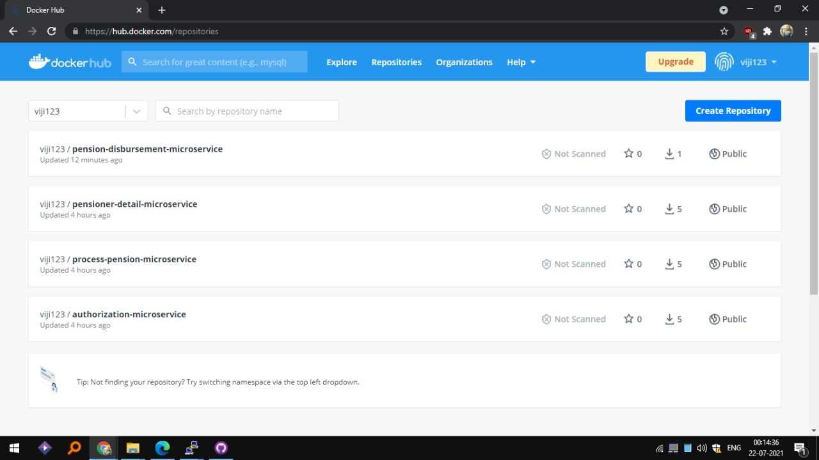
Docker Images and Instances

Slide 22
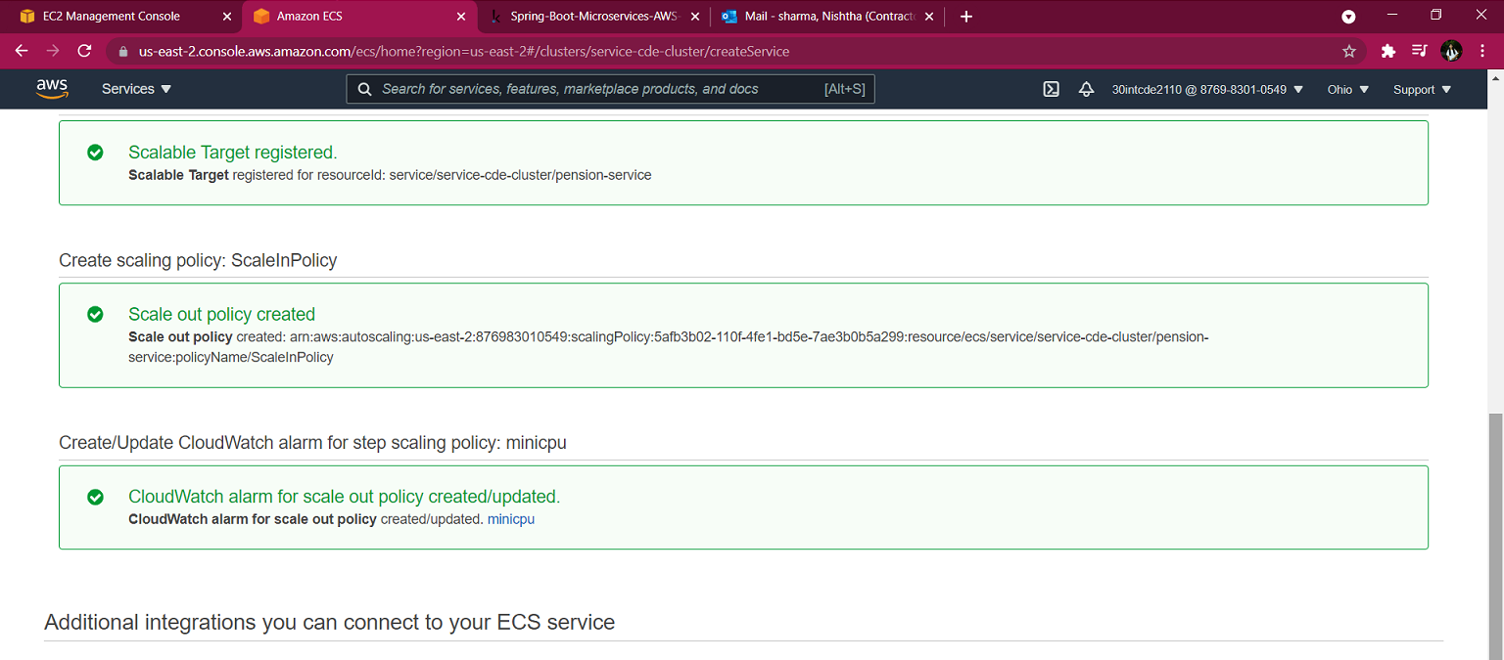
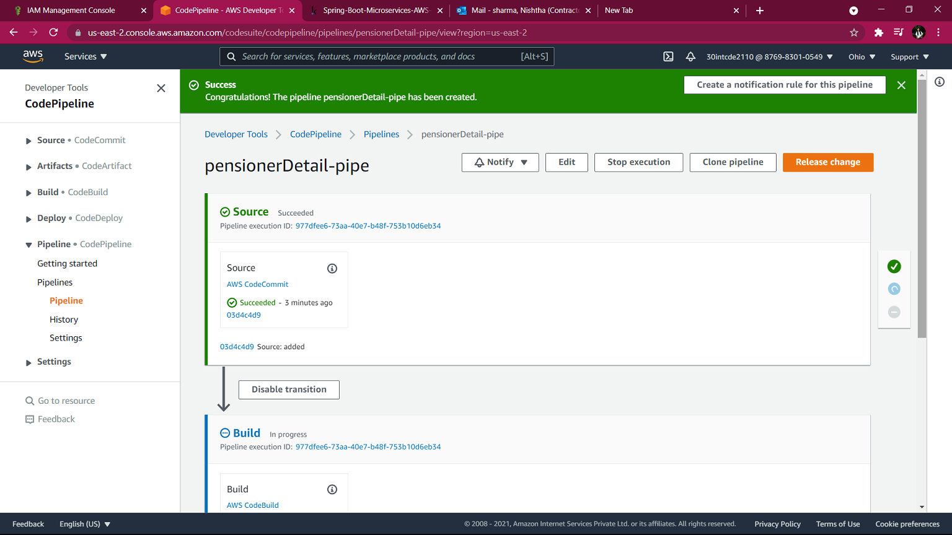
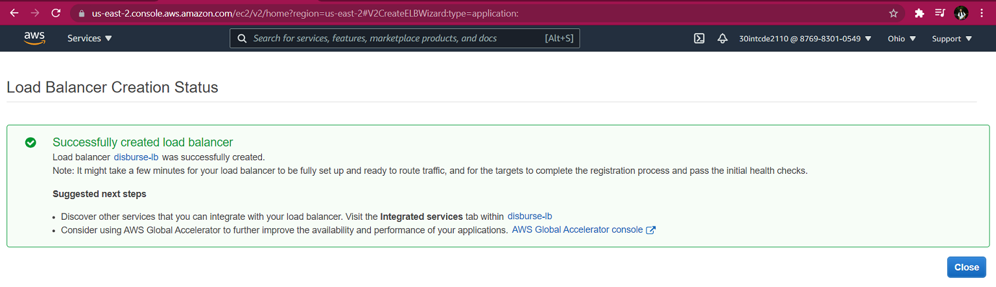
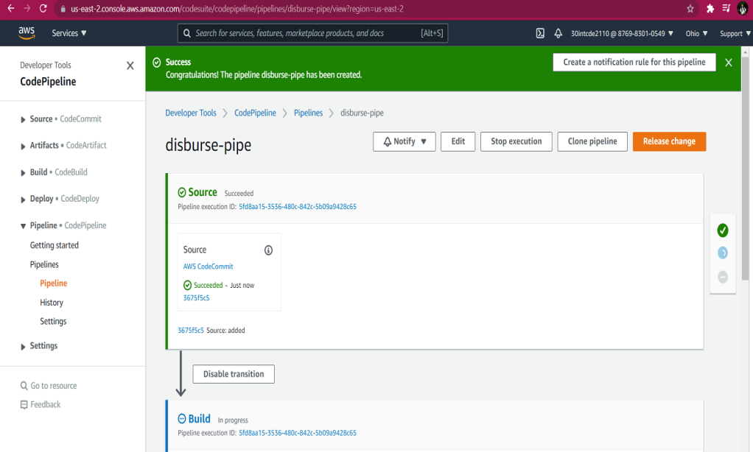
Load Balancer and Pipeline

Slide 23
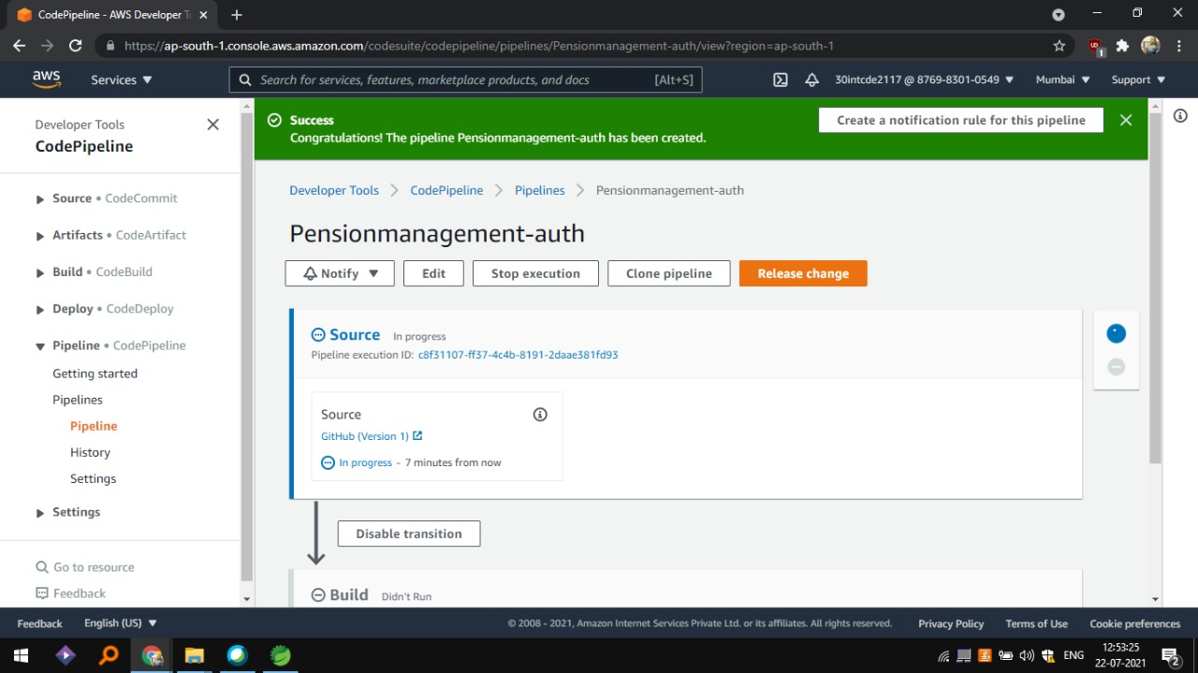
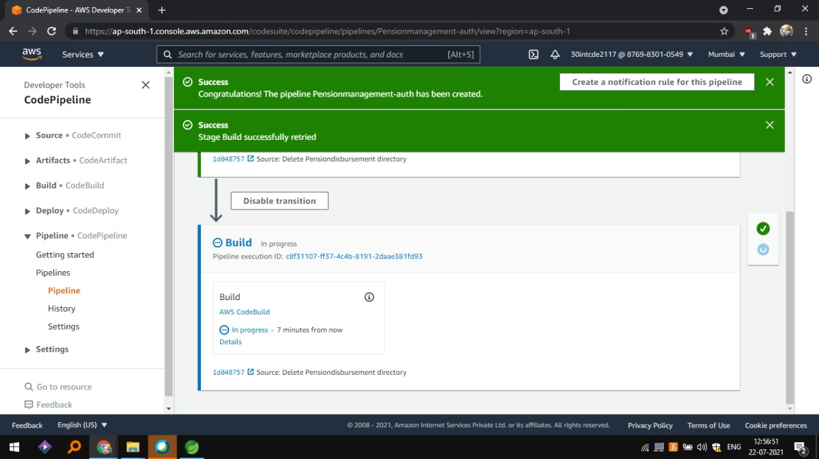

Slide 24
THANKYOU

